Slide 1
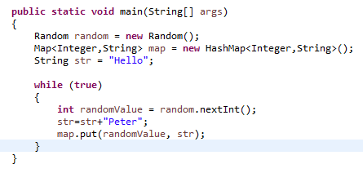

The OutOfMemoryError in Java
The OutOfMemoryError is thrown due to lack of available memory space. The garbage collector is responsible for detecting objects that are not being used or referenced and collect them. In this way, memory space is being reclaimed for Java applications. However, there are cases where the garbage collector cannot reclaim portions of memory, despite the fact that these objects are no longer accessible by the Java application. These are called memory leaks and can severely limitate the available memory space.

